Slide 1
Terraform and Ansible Integration

Slide 2

Hello!
Terraform + Ansible
Terraform and Ansible can be used in tandem to dynamically deploy infrastructure and applications leaning on the strength of each tool.

Slide 3




Common Infrastructure Automation Tasks
Infrastructure Deployment
Configuration Management
Deployment Orchestration
Testing and Validation
Notes:
Immutable infrastructure deployment
Configuration management
Deployment orchestration
Testing and validation

Slide 4
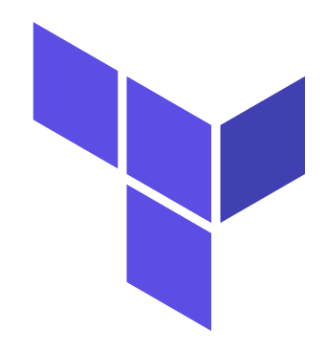
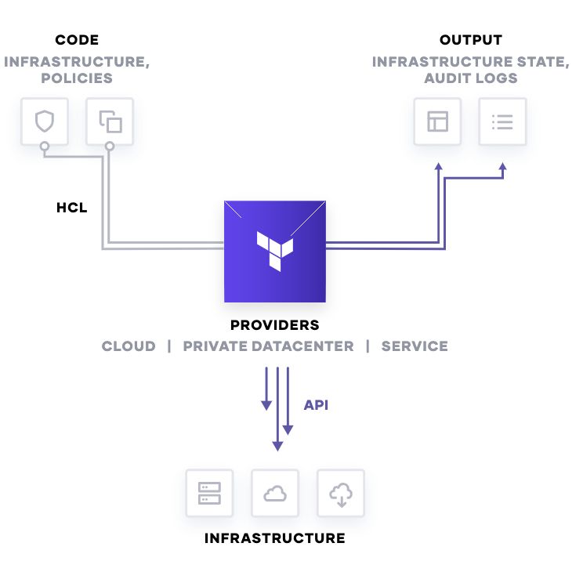
HashiCorp Terraform
Provides the foundation for infrastructure automation
Open-source application automating infrastructure
Codifies application infrastructure
Manages infrastructure across multiple clouds
Deploys infrastructure consistently and reproducibly

Slide 5





Benefits of Terraform
Declarative Configuration
Immutable Infrastructure
API-driven and Agnostic
Separates Planning and Execution

Slide 6
Drawbacks of Terraform
Not task oriented
No configuration management
No custom checks
State file dependency

Slide 7

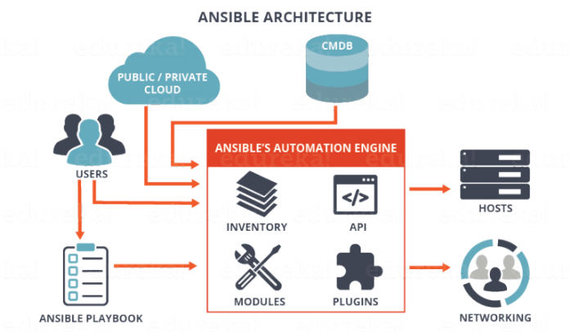
Red Hat Ansible
Automates the deployment and management of applications
Open-source application automating operations
Codifies application configuration in tasks
Manages infrastructure across multiple clouds
Configures and maintains application platforms

Slide 8




Benefits of Ansible
Agentless Architecture
Configuration Management
Task and Module Driven
Orchestrate Workflows

Slide 9
Drawbacks of Ansible
No local state and constant refresh
Internal logic and no dependencies
Difficult to parallelize
Requires remote access to system

Slide 10
Workflow Integrations
CI/CD

Slide 11


Terraform Calling Ansible (Local)

Slide 12
Terraform Calling Ansible (Remote)

Slide 13


Ansible Calling Terraform
Playbook

Slide 14

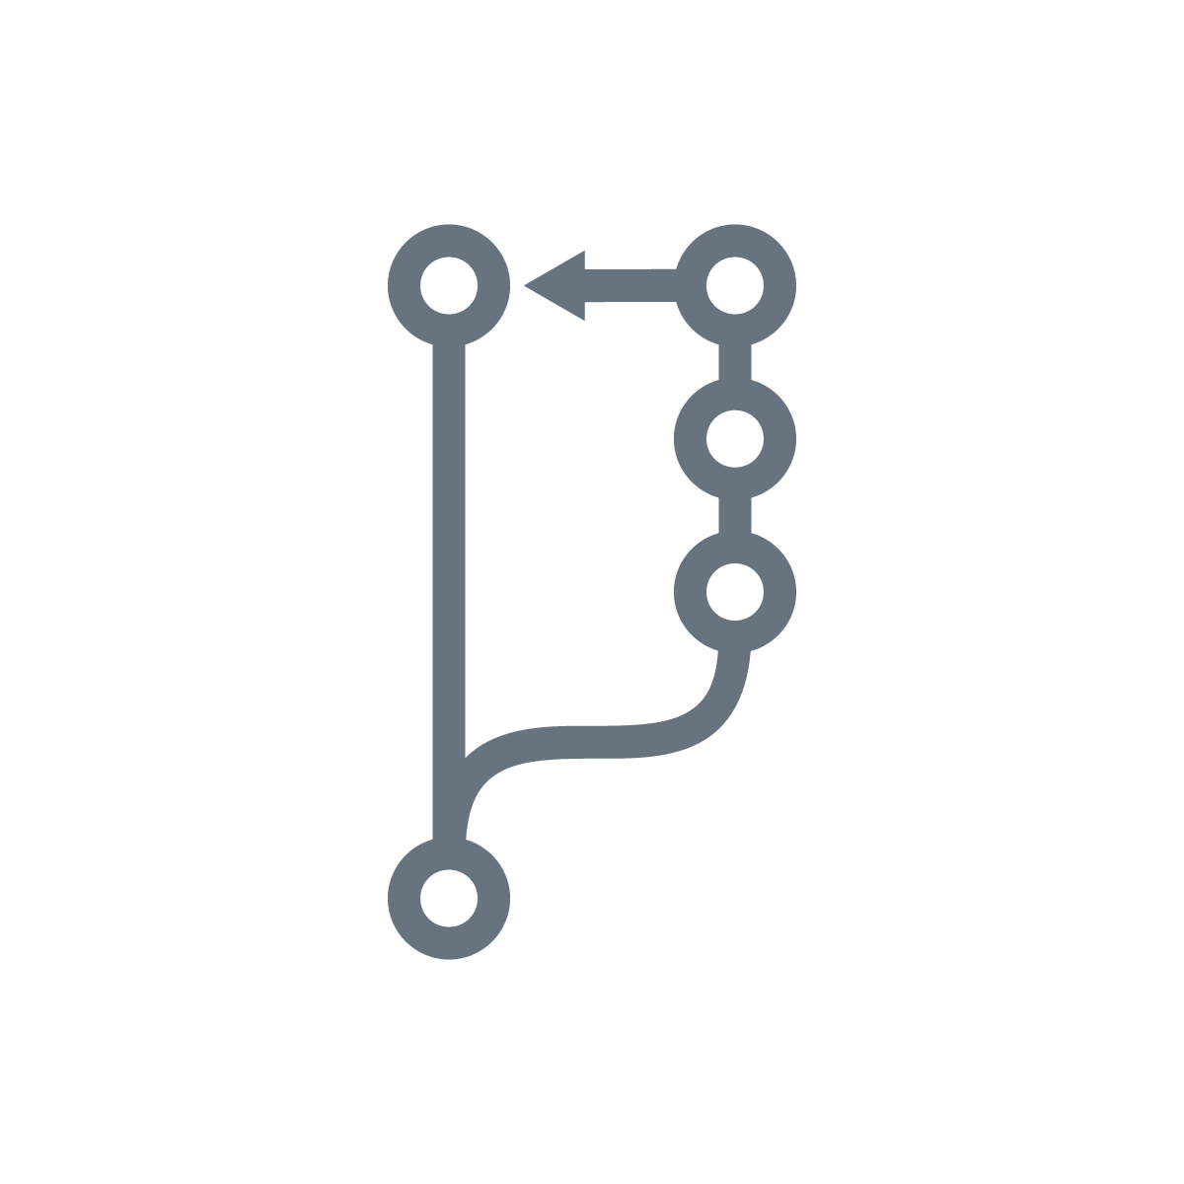

Jenkins Orchestration

Slide 15

Summary
Terraform excels at deploying immutable infrastructure
Ansible is perfect for configuration management and task oriented workflows
Terraform and Ansible work better together for complete application deployment and management

